Slide 1


Spotify
Song Webpage

Slide 2

Upgrade
Prianshu
Welcome
About Us
Our Teams
Welcome
Agenda
Our Services
The largest on-demand music service in the world and growing fast. They operate on a “premium” model where users can search music by artist, album, playlist on record label. With premium, users can avoid advertisements and download the music. Tens of millions of daily Spotify users generate data that gives Spotify a unique opportunity to develop their products and service based on user behavior.
Achievements
Our Goals
Gallery
Play
Follow
Pricing
Contact Us

Slide 3
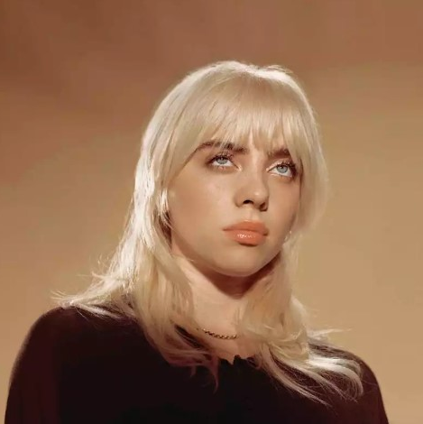


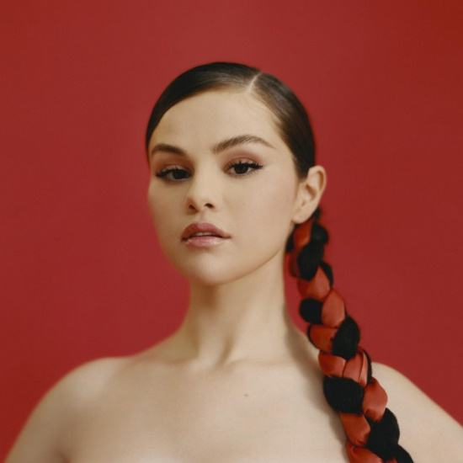
Upgrade
Prianshu
Welcome
About Us
Our Teams
Our Teams
Agenda
Our Services
Achievements
Our Goals
Gallery
Pricing
Aditya Chavhan
Prianshu Khalde
Tejaskumar Chopade
Sanket Dubal
Contact Us
Artist
Artist
Artist
Artist

Slide 4




Upgrade
Prianshu
Welcome
About Us
Our Teams
Summary
Agenda
Our Services
Spotify is a leading online music streaming application with over 100 million users worldwide. A huge milestone as Spotify has it’s presence in only 60 nations in the world unlike its competitors. The marketing plan suggests ways to attract the target consumers, and the most efficient way to position, offer and communicate the target consumer segments.
Goal 01
Goal 02
Achievements
Our Goals
Gallery
Goal 03
Goal 04
Pricing
Contact Us

Slide 5




Upgrade
Prianshu
Welcome
About Us
Our Teams
Gallery
Agenda
Our Services
Achievements
Our Goals
Gallery
Pricing
Contact Us

Slide 6

Upgrade
Prianshu
Welcome
About Us
Our Teams
Pricing
Agenda
Our Services
Spotify offers over 30 million songs from various genres with a user friendly interface.
User can listen to their favorite artist, album, and discover new music in an easy manner.
Spotify provides two versions of its application – Free an Premium Subscription.
Premium Subscription is offered to an individual at a price of Rs.100/-
Achievements
Our Goals
Gallery
Pricing
Contact Us

Slide 7


Upgrade
Prianshu
Welcome
About Us
Tools and Platform
Despacito
Our Teams
Agenda
We have used HTML and CSS programming languages for making this Spotify app webpage.
This system can be executed on any platform. It is a platform independent system.
Our Services
Achievements
Phone :
+91 9820487682
Our Goals
Despacito
Luis Fonsi, Daddy Yankee
Gallery
Address :
NCER, Talegaon Dabhade, Pune
0:23
-3:25
Pricing
Contact Us
Follow us :
@spotifyofficial

Slide 8

Thank You
Minjra
Aditya Chavhan, Prianshu Khalde
0:23
-3:25

